Slide 1
Adding process to increase quality without adding tests
SOFTWARE QUALITY CONFERENCE
PACIFIC NW
Michael millerick 14 October 2019
PNSQC ™

Slide 2
Background
SOFTWARE QUALITY CONFERENCE
PACIFIC NW
Blend’s application is browser based
We eliminated most of our manual regression by adding automated end-to-end (E2E) tests
Many of the automated tests were flakey
Non-deterministic test behavior?
Non-deterministic application behavior?
PNSQC ™
Notes:
Flakey: tests that fail but will succeed given sufficient retries
Important to note that there are two primary sources of flakes:
Non-deterministic test behavior
Non-deterministic application behavior
We wanted to provide a very stable environment for tests to run in to isolate the cause

Slide 3
Problem Statement
SOFTWARE QUALITY CONFERENCE
PACIFIC NW
Reduce runtime of E2E tests by reducing number of retries needed to pass
Give engineers confidence that failed test runs indicate needed changes
PNSQC ™
Notes:
The runtime was frequently 40+ minutes, which made the iteration cycle longer than desirable
By making the end to end tests more stable, we hoped to give engineers more confidence in the tests, and find areas of the application that needed to be made more stable

Slide 4
Overview
SOFTWARE QUALITY CONFERENCE
PACIFIC NW
Defined ownership and created analytics for tests
Built tools to facilitate the merge process
Eliminated the escape hatch
Improved scalability of test infrastructure
PNSQC ™

Slide 5
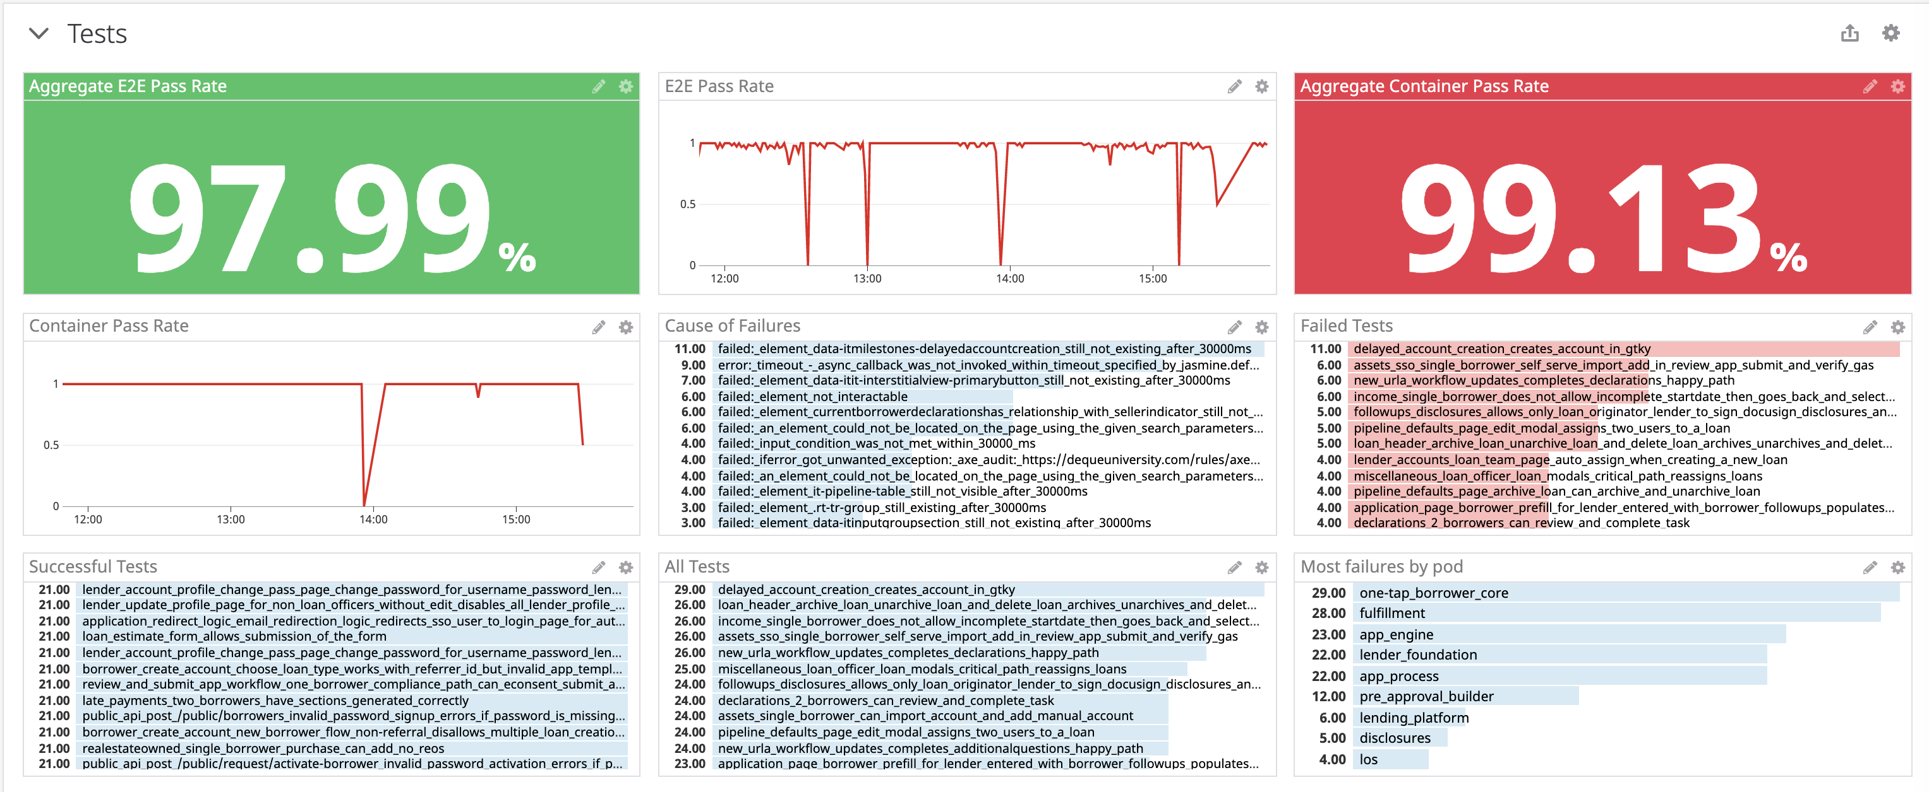
Ownership & Analytics
SOFTWARE QUALITY CONFERENCE
PACIFIC NW
We used Datadog to monitor tests across all pull requests.
Made it difficult to separate noise from signal.
PNSQC ™
Notes:
Problems with datadog:
We could only aggregate across every run of a test. It was very difficult to ignore failures caused by infrastructure issues and test runs on pull requests that produced hundreds of legitimate failures.
Datadog would frequently choke if we tried to look at more than two days worth of data. This made it hard to find trends overtime.

Slide 6
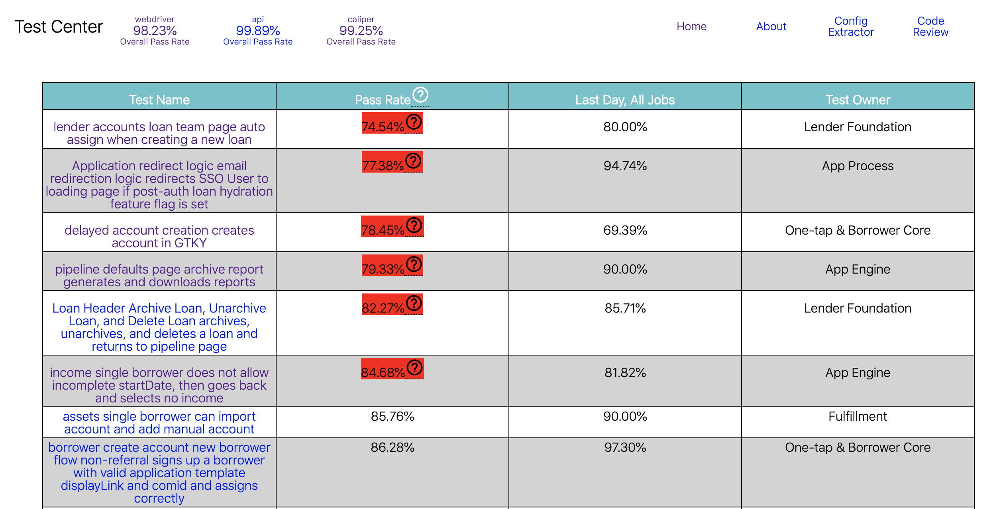
Ownership & Analytics
SOFTWARE QUALITY CONFERENCE
PACIFIC NW
We wanted to perform SQL-like operations in Datadog to filter out the noise, so we started storing test results in a Postgres-backed service, called Test Center.
PNSQC ™
Notes:
With the transition, we also identified an owner for each test and began storing that information in Test Center as well.

Slide 7
Ownership & Analytics
SOFTWARE QUALITY CONFERENCE
PACIFIC NW
Classify all tests results based on whether or not they could be used to merge a pull request.
Test Run | Attempt | Result
1 | 1 | Pass
Test Run | Attempt | Result
1 | 1 | Pass
2 | 1 | Fail
2 | 2 | Fail
2 | 3 | Fail
Test Run | Attempt | Result
1 | 1 | Pass
2 | 1 | Fail
2 | 2 | Fail
2 | 3 | Fail
3 | 1 | Fail
3 | 2 | Pass
Run 1: Passed, results can be used (1 pass, 0 fail)
Run 2: Failed, results cannot be used
Run 3: Passed, results can be used (1 pass, 1 fail)
“Good job” pass rate: 66% (2/3)
PNSQC ™
Notes:
Used good job pass rate to compare to a threshold.

Slide 8
Ownership & Analytics
SOFTWARE QUALITY CONFERENCE
PACIFIC NW
PNSQC ™
Notes:
This was the distribution of test pass rates using the logic I just described when started the migration. A total of 87 tests with a pass rate below 90%. Today we only have 20 tests that are below 90% pass rate, and all of those have more than an 80% pass rate.

Slide 9
Tools
SOFTWARE QUALITY CONFERENCE
PACIFIC NW
Merge bot
Slack notifications for test failures
Jira issue tracking for flakey tests
Test status indicators in Slack
PNSQC ™

Slide 10
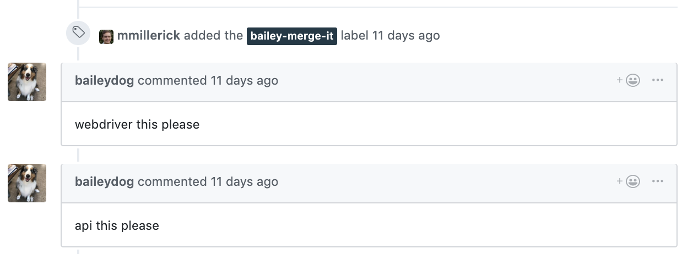
Tools
SOFTWARE QUALITY CONFERENCE
PACIFIC NW
Merge bot
A label applied to Github pull requests when they were ready to merge
A bot would apply comments to the pull request to rerun tests and merge the pull request
Benefits
Engineers no longer need to monitor their pull requests
Eliminated the thundering herd effect
Allowed us to better use our infrastructure around the clock
PNSQC ™
Notes:
In order to merge code, comments need to be applied to pull requests, both to run tests as well as for the final merge action.

Slide 11
Tools
SOFTWARE QUALITY CONFERENCE
PACIFIC NW
Slack notifications for test failures
Delivered a link to Test Center via slack when tests failed
Made it clear which engineering team owned the test that failed
Benefits
Gave engineers a good indication of whether or not the failure was from a flake
Reduced the number of tests that were blindly rerun
PNSQC ™

Slide 12
Tools
SOFTWARE QUALITY CONFERENCE
PACIFIC NW
Jira issue tracking for flakey tests
On a daily basis, automatically create and assign out Jira issues for flakey tests
Send reminders to teams via Slack that they had outstanding flakey tests
Closes the Jira issues automatically if the tests are no longer flakey
Benefits
Teams have an indicator in their JIRA backlog that they have flakey tests to fix.
PNSQC ™

Slide 13
Tools
SOFTWARE QUALITY CONFERENCE
PACIFIC NW
Test status indicators in Slack
Test Center constantly checks if it is impossible to pass tests
Based on findings, status indicators are set in the engineering support channel
Benefits
Engineers are now aware when it does not make sense to run tests
Teams are quickly aware when tests are broken
PNSQC ™

Slide 14
Eliminate the Escape Hatch
SOFTWARE QUALITY CONFERENCE
PACIFIC NW
We frequently found ourselves trapped in this vicious cycle
Outage
Skip pull requests past tests
Fix cause of outage
PNSQC ™
Notes:
An escape hatch was built early in the company’s history to bypass tests when merging pull requests. The escape hatch was used to merge with the comment “bailey skip it” instead of “bailey merge it”.
This worked well when there were just a handful of engineers at the company who knew all of the code and were good at determining whether or not it was safe to skip tests. As the organization grew, the escape hatch was used more and more frequently as a mechanism to bypass tests when they, or the infrastructure they run on, was broken.
This lead to a vicious cycle…

Slide 15
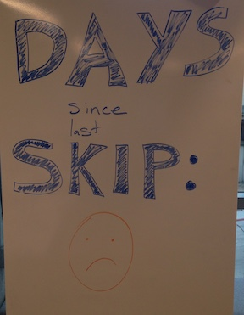
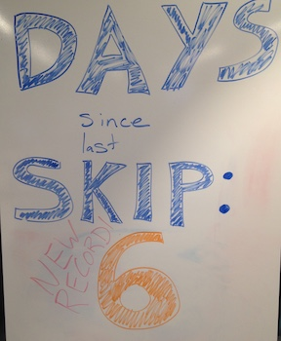
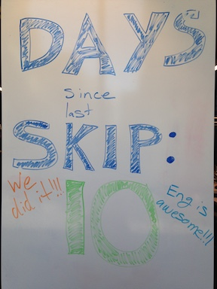
Eliminate the Escape Hatch
SOFTWARE QUALITY CONFERENCE
PACIFIC NW
After rolling out the merge bot, we also started tracking number of days since the escape hatch was used
Proved to the organization that the escape hatch was not necessary
PNSQC ™
Notes:
Eliminating the escape hatch was important since we used the tests to eliminate the manual regression, so if engineers were skipping the tests, there wasn't anything protecting us from releasing bugs into production.

Slide 16
Scalability
SOFTWARE QUALITY CONFERENCE
PACIFIC NW
Improved parallelization of tests
Created a sandbox for each test to operate in
Moved the tests from Jenkins onto Kubernetes
PNSQC ™
Notes:
Points 1 and 2 go hand in hand. We used improved sandboxes as our parallelization mechanism.

Slide 17
Scalability
SOFTWARE QUALITY CONFERENCE
PACIFIC NW
Original retry methodology
All tests operated in the same configuration space
Retries staggered themselves, no retries would happen until all tests completed
Test 1
Attempt 1
Test 1
Attempt 2
Test 1
Attempt 3
Test 1
Attempt 4
Test 2
Attempt 1
Test 3
Attempt 1
Test 3
Attempt 2
Test 3
Attempt 3
Test 4
Attempt 1
Test 5
Attempt 1
Test 5
Attempt 2
Time
PNSQC ™
Notes:
Using the options for parallelizing given to us by our test framework, this type of staggering pattern is what resulted.

Slide 18
Scalability
SOFTWARE QUALITY CONFERENCE
PACIFIC NW
Improved retry methodology
Each test is isolated in its own sandbox
Retries are naturally compressed
Test 1
Attempt 1
Test 1
Attempt 2
Test 1
Attempt 3
Test 1
Attempt 4
Test 2
Attempt 1
Test 3
Attempt 1
Test 3
Attempt 2
Test 3
Attempt 3
Test 4
Attempt 1
Test 5
Attempt 1
Test 5
Attempt 2
Time
PNSQC ™
Notes:
Sandboxes were created using the multitenancy features of our application. One application instance can serve multiple different customers, for tests we just created many different tenants that could be used to sandbox the tests and isolate their configuration from each other in the same way that configuration is isolated for our customers in production. If we wanted to run 15 tests in parallel, we would create 15 tenants, and run 15 tests against against those 15 tenants, one test per docker container. When one test would finish we would start a new test in a new docker container against the freed up tenant until we had finished all of those tests. This leads to the compression.

Slide 19
Scalability
SOFTWARE QUALITY CONFERENCE
PACIFIC NW
Further improved how we group tests together
Round robin grouping
Test 1
Test 2
Test 3
Test 4
Test 5
Duration-based grouping
Test 1
Test 3
Test 4
Test 5
Test 2
Time
PNSQC ™
Notes:
The pattern I just described is what I call round robin grouping. We realized we could do better and group in a more optimal fashion.
We used historical data from Test Center in order to determine which tests could be run together in order to ensure that all tests finished at about the same time.
In this example, Test 2 takes four times as long as any of the other four tests. If we were trying to run two tests in parallel, the most optimal thing to do would be to run the four short tests against a single tenant, and run the longer test against its own tenant. This provided an optimal run time for tests.

Slide 20
Scalability
SOFTWARE QUALITY CONFERENCE
PACIFIC NW
Jenkins
Does not take load into account when scheduling
Our Jenkins setup did not autoscale
Kubernetes
Can provide specific CPU and Memory requirements
Nodes autoscale
PNSQC ™

Slide 21
Results
SOFTWARE QUALITY CONFERENCE
PACIFIC NW
These changes allowed us to release more frequently
PNSQC ™
Notes:
Since early 2018 when many of the tools described were rolled out to the organization, we’ve been able to release more often.

Slide 22
Results
SOFTWARE QUALITY CONFERENCE
PACIFIC NW
Improved the stability of the tests
Allowed us to find flakey application behavior
PNSQC ™

Slide 23
Results
SOFTWARE QUALITY CONFERENCE
PACIFIC NW
Reduced the amount of time engineers had to wait for tests to complete
PNSQC ™
Notes:
wall clock

Slide 24
Results
SOFTWARE QUALITY CONFERENCE
PACIFIC NW
Reduced the amount of compute resources needed to run tests
PNSQC ™

Slide 25
Contact & Questions?
SOFTWARE QUALITY CONFERENCE
PACIFIC NW
mmillerick@blend.com
https://blend.com/
PNSQC ™

